Slide 1
Qualification project «Warestore»
The work was performed by: Evgeny Timofeev
Mentor: Emelin Egor

Slide 2
Problem formulation
The task was to implement an online store for the sale of weapons based on a client-server connection between the Internet page and the server.
The program must contain a set of basic operations, such as: authorization, registration, making a purchase, changing the profile Info and view order history.

Slide 3
Technology stack
Spring base:
spring-boot-starter-web
spring-boot-starter-validation
spring-boot-starter-thymeleaf
spring-boot-starter-security
spring-boot-starter-jersey
spring-boot-starter-web-services
lombok
Swagger:
springfox-swagger2
springfox-swagger-ui
PostgreSQL:
postgresql
spring-boot-starter-data-jdbc
spring-boot-starter-data-jpa
Java Web Token:
jjwt
Mail:
spring-boot-starter-mail
Couchbase:
spring-data-couchbase
java-client (couchbase)

Slide 4
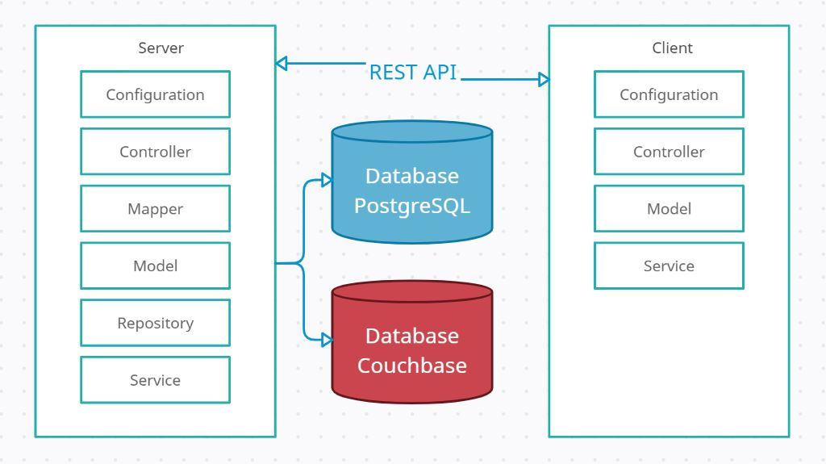
Program architecture

Slide 5
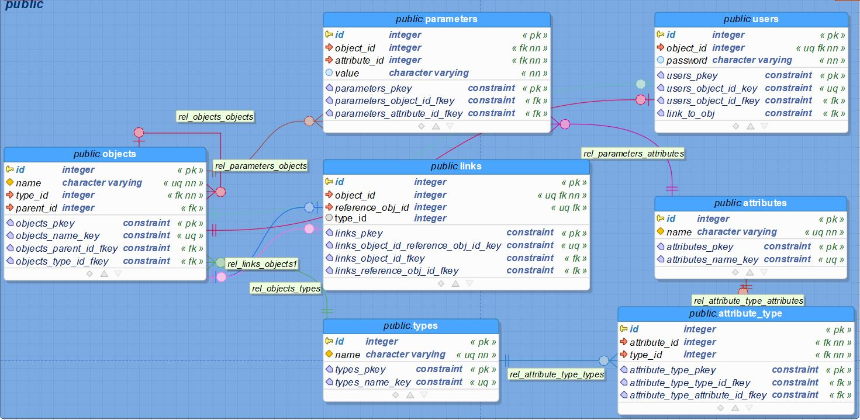
Database schema

Slide 6
Server application
It’s a RESTful application.
This application writes information to database (PostgreSQL) and Couchbase, return and protect information by spring security & java web token, has a REST endpoints to interaction with itself.

Slide 7
Client application
It’s a web view application.
This application connects to a server application for post/retrieve information and return web pages, manages web pages and creates requests to the server to receive or send information, and also processes the server response.

Slide 8
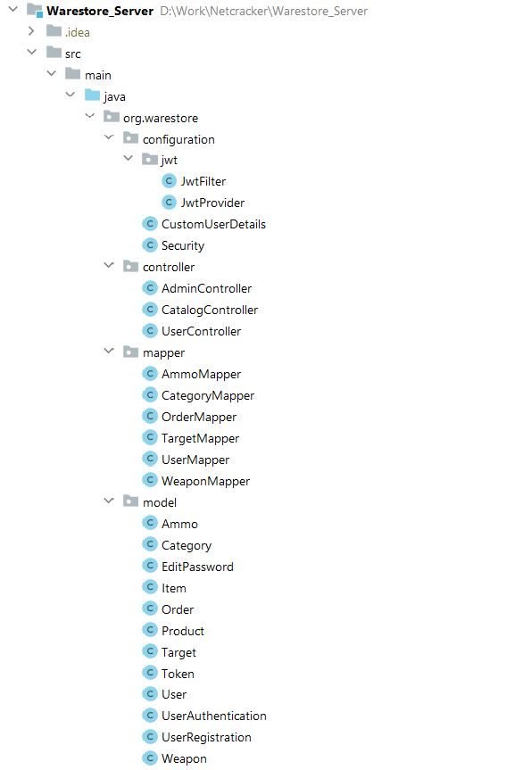
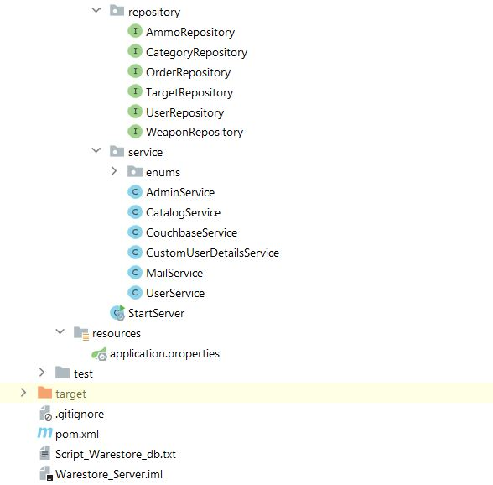
Program implementation Server application

Slide 9
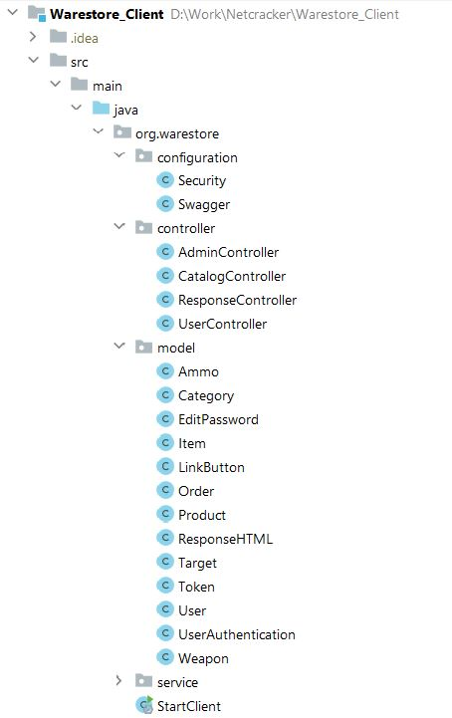
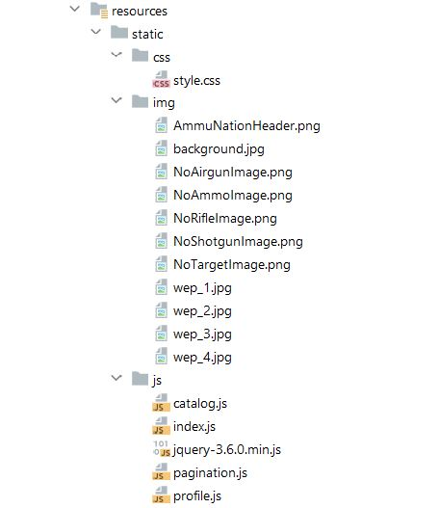
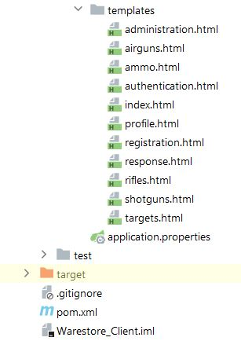
Program implementation Client application

Slide 10
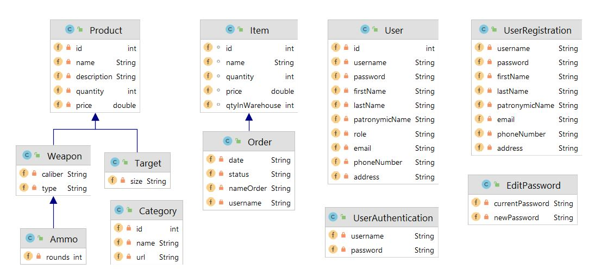
Models Server application

Slide 11
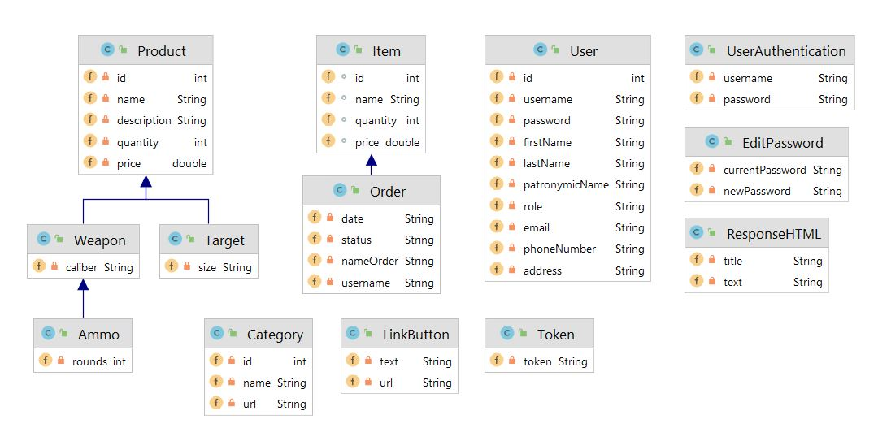
Models Client application

Slide 12
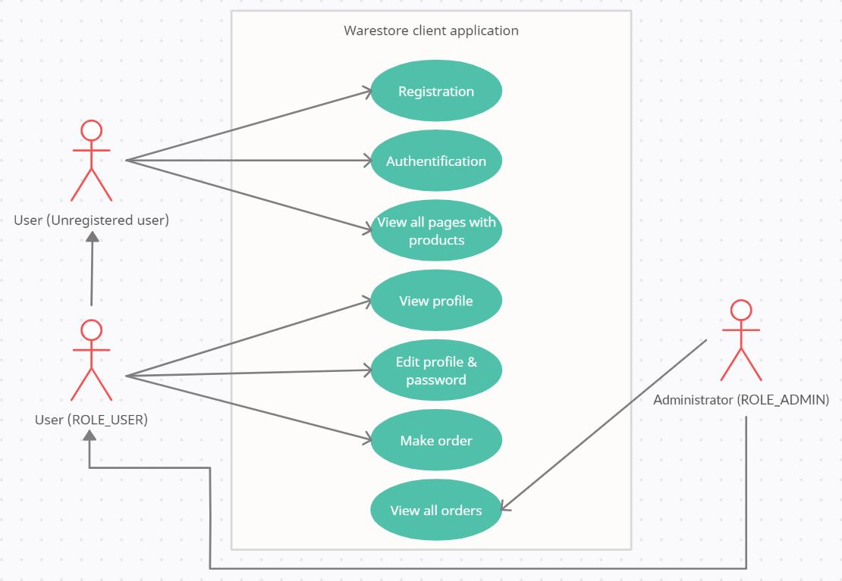
Use Case diagram template

Slide 13
Sources
Server application: https://github.com/Warestone/Warestore_Server
Client application: https://github.com/Warestone/Warestore_Client

Slide 14
Conclusion
Now, let's see the project in action…

